Slide 1
Chapter 4
Basic information security model

Slide 2
Overview
The elements of the basic information security model
The relationships between the elements of the basic information security model
The common classification of information security controls

Slide 3
Background
Any vulnerability in the organization will be exploited
All aspects of the organization need to be examined to identify vulnerabilities
Helps to organize scope of activities
Called “basic information security model” in this course

Slide 4
Basic information security model

Slide 5
Basic model (contd.)
Model
Representation of the real world
Draws attention to the essential elements of a problem
Information security model
Will include core components of information security
Show relationship of components to each other
Exclude everything else

Slide 6
Basic model (contd.)
4 components
Assets
Vulnerabilities
Threats
Controls
All information security activities fall into one or more of these components
Each component discussed in a following chapter
Overview provided here

Slide 7
Assets
Definition
Resource or information to be protected
All security efforts protect assets
Not just information security
e.g.
National security: Defend nation’s autonomy
Asset = national autonomy
Home security: Defend home against break-ins
Asset = home

Slide 8
Information assets vs. physical assets
In traditional security
Assets are visible, e.g.
Home
Car
Intrusions are visible, e.g.
Broken windows
Shattered glass
Intruders are often local
Difficulty of transporting assets

Slide 9
Information assets vs. physical assets
In information security
The most valuable assets are invisible, e.g.
Student assignments in a file system
Customer information in a database
Most intrusions are invisible, e.g.
Google’s code stolen by foreign students
Viruses entering in email
Intruders are often foreign and invisible (difficult to track)
Information transport is relatively easy, inexpensive and fast
Protection from legal response
Invisibility of assets is a general challenge in information security

Slide 10
Information assets vs. physical assets
Duplicability
Information assets are not just invisible
They are also costless to replicate
Physical theft visible
Vandalized car noticeable even to strangers
Information theft not visible
Information theft not visible even to owners, e.g.
How do you know if your assignment was copied without your permission?
Duplicability of assets is another general challenge in information security

Slide 11
Information vs. physical security
Differences
Invisibility
Duplicability
Consequences
Physical deterrence has limited impacts
Locks, cameras etc.
Asset recovery is meaningless
You can return a stolen car
What does it mean to return stolen information?
100’s of potential copies in no time, at little cost
Information in these copies is usable

Slide 12
Asset representation in model
Gold
Centuries-old traditional measure of economic value
Hence gold-bars in model
Note:
Today, information assets are potentially far more valuable than gold assets
Stored in IT system
Definition of IT system
Assembly of computer hardware, software and firmware, configured for the purpose of processing, storing or forwarding information
E.g.: Excel spreadsheet on PC, ERP system

Slide 13
Vulnerabilities
Definition
Weaknesses in a system that can be exploited
All systems have vulnerabilities, e.g.
Hard drive crashes
Theft
Technology improving with every release
However, products also getting increasingly complex
Tens of millions of lines of code
Thousands of co-operating developers
But human vulnerabilities remain, e.g.
Weak passwords, ignorance

Slide 14
CVE and NVD
CVE
Common vulnerabilities and exposures
Provide common names and identifiers for all publicly known software vulnerabilities
Facilitates discussion
Maintained by Mitre
Non-profit R&D organization
NVD
National vulnerabilities database
Likely impacts of each CVE vulnerability
Recommended measures to remove each CVE vulnerability
Industry-government collaboration

Slide 15
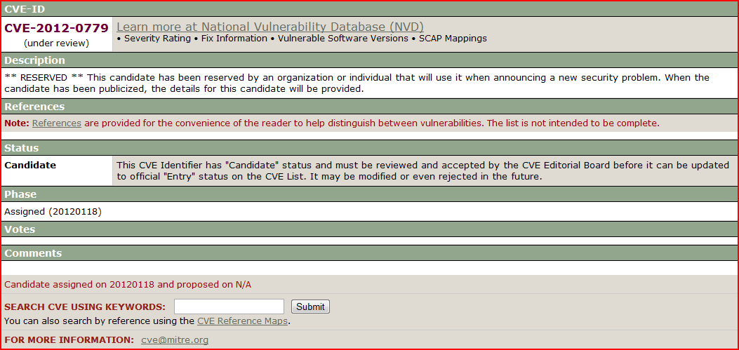
CVE example

Slide 16
Notable features of CVE and NVD
Link between CVE and NVD
Most vulnerabilities typically reported by vendor itself
i.e. vulnerability has been verified to exist
Added to CVE database after public report
Detailed information about the vulnerability usually found at the vendor’s site
CVE not “whistle-blower” or “watchdog”
CVE and NVD are primarily central repositories of known vulnerabilities

Slide 17
Vulnerability statistics
Average of 11 reported vulnerabilities/ day (May 2012)
Mostly reported by vendors themselves
New vulnerabilities*
2010: 6,253
2011: 4,989
Drop: ~20%
Attacks*:
2010: 5.5 billion
2011: 3 billion
Industry publishes top 25 vulnerability causing errors for the year from this database

Slide 18
Threats
Definition
Capabilities, intentions and attack methods of adversaries to exploit or cause harm to information
Examples
Someone trying to steal intellectual property
Someone trying to guess passwords
Model representation
Shown as arrows in basic model

Slide 19
Threats evolution
80’s
Pranks
No malicious intention
2000
Disruptive
Malicious
Denial of service outcomes
Yet, not particularly profit seeking
2010+
Primarily profit seeking

Slide 20
Threat monitoring
Counterpart to vulnerability database
Industry interest
Atlas threat monitor
Uses sensors deployed at major ISPs worldwide

Slide 21
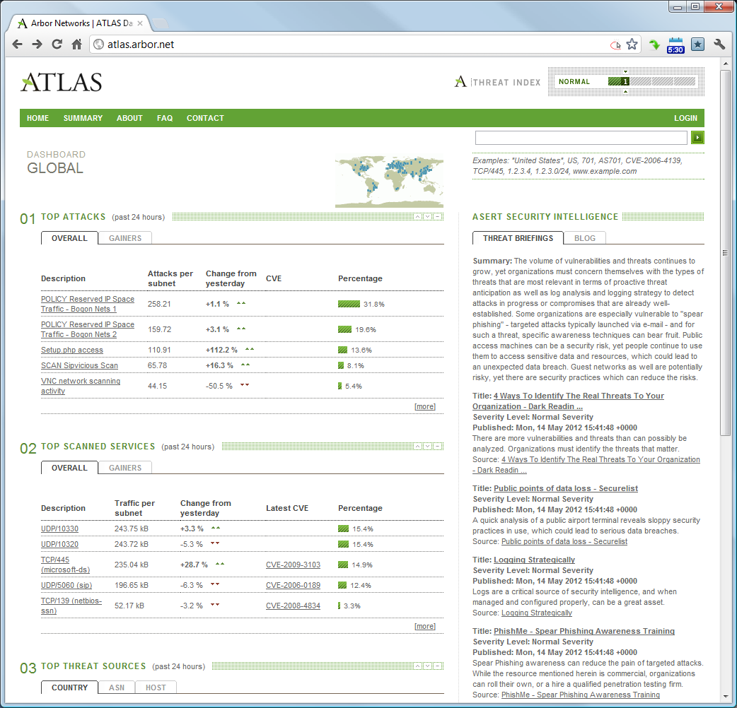
Atlas threat monitor interface

Slide 22
Threat industrialization
Information security attacks targeted towards profit-seeking
E.g. Ramnicu Valcea, Romania*
Town built around “hacking”
Led to the development of tools
Integrated development environments and toolkits
Zeus, Spyeye
Remove entry barriers
No more creating exploits from first principles
Wider population can become attackers

Slide 23
Controls
Definition
Safeguards used to minimize the impact of threats
Vulnerabilities and threats not going away
System administrator response?
Controls
Examples
Strong passwords
Password enforcement
Backups
Model representation
Protective ring around IT system

Slide 24
Controls effectiveness
Simple controls can be very effective
Passwords
Personal firewalls
Backups
Only a small fraction of threats actually cause damage
But one successful threat can be lethal
May not be detected until late
Information security goal
Deploy appropriate controls
Not all possible controls
Maximize returns from security investment

Slide 25
Common vulnerabilities
Later chapters focus primarily on controls
Awareness of important vulnerabilities is helpful
Simple classification scheme
Software vulnerabilities
Error in specification, development or configuration of software such that its execution can violate the security policy
Procedural vulnerabilities
Weakness in an organization’s operational methods, which can be exploited to violate the security policy

Slide 26
Software vulnerabilities
Lack of input validation
User input not verified for appropriateness
Lethal in web software
User input used as parts of SQL queries into databases
Knowledgeable user can exploit input
Example
query = "SELECT * FROM items WHERE itemname = '" + ItemName.Text + "'";
// expected user input for ItemName: pencil;
// actual user input for ItemName: pencil OR 'a'='a';
// query result is:
SELECT * FROM items WHERE itemname = pencils OR 'a'='a';
// which translates to:
SELECT * FROM items;

Slide 27
Software vulnerabilities (contd.)
Lack of input validation
Source of numerous attacks in 2008 – 2011 timeframe
E.g. Sweetbay, PBS Frontline, HB Gary Federal and Sony Pictures
Specific form shown in example is called SQL injection
Definition
Use of unvalidated SQL input in applications

Slide 28
Software vulnerabilities (contd.)
Unverified uploads
Files are accepted by software without verifying that the file follows strict specifications
Example
File uploads on web sites
Expected file type: images, videos
Actual file type: input logger, robot etc.
All uploaded files should be checked for malice
Not trivial
Image file formats allow text inputs in EXIF data
Also, unverified data at the end of the file

Slide 29
Software vulnerabilities (contd.)
Cross-site scripting
Definition
User-supplied input is used without verification as part of the output served to other users
Abbreviated as XSS
Common scenario
Forum posts may have html links with embedded JavaScript
If a user clicks the link, the JavaScript is activated in the background
JavaScript can take information from forum and apply it to link target
Hence the name cross-site
Information from one site (forum) used to compromise another website

Slide 30
Software vulnerabilities (contd.)
Buffer overflow
Definition
Program puts more data into a storage location than it can hold
Usually benign
Only causes software crash
However
Knowledgeable user can craft special input to make program crash in predictable ways
Goal is generally to get a remote connection
As administrative user if possible
Avoidance requires careful programming

Slide 31
Software vulnerabilities (contd.)
Missing authorization
Program allows users access to privileged parts of the program without verifying the credentials of the user
Possible due to project management oversight in large web sites
Example
May 2011, Citigroup
Hundreds of thousands of bank accounts compromised

Slide 32
Software vulnerabilities (contd.)
Unencrypted data
Sensitive data is stored locally or transmitted over a network without proper encryption
Examples
Email user names and passwords
Unencrypted hard drive in stolen laptops

Slide 33
Procedural vulnerabilities
Password procedures
Effective passwords must be required
4 components of password procedures
Length
8 or more characters
Complexity
Numbers, letters and punctuations must be required
Variation
Change periodically so that any theft is eventually ineffective
Variety
Different passwords for different sites
At least distinguish between financial and non-financial passwords

Slide 34
Procedural vulnerabilities (contd.)
Training procedures
Employees must know what actions have information security implications
Employees must know what to do in these situations
Minimal procedures and training
Employees must never be asked for user credentials on the phone or online
Employees must know they should never act on such requests
Attends to most common social engineering and phishing threats

Slide 35
Threats
Limited only by the imagination of the attacker
Hence impossible to catalog
Only look at the best known threats
Viruses/ worms
Programs that adversely affect computers and propagate through the network without the user's consent
Modern viruses cause all possible damage within few minutes
E.g. Slammer worm, Jan 25, 2003
Reached 90% of all vulnerable targets within 10 minutes of release
ILOVEYOU virus
International legal differences became apparent

Slide 36
Threats (contd.)
Denial of service
Unauthorized prevention of access to resources or the delaying of time-critical operations
Usually by making numerous unnecessary requests
Commonly known by abbreviation
DOS
Distributed DOS
Use of many compromised systems to cause denial of service for users of the targeted system
Often, relatively straightforward to respond
Steve Gibson’s report extremely readable and informative

Slide 37
Threats (contd.)
Malware
Any software or code specifically designed to exploit a computer, or the data it contains, without consent
Usually
Key loggers
Track (log) keys struck on a keyboard, typically trying to gather usernames and passwords
Zombie clients
Software that takes directions from a remote computer and uses the infected computer to perform malicious tasks as directed
Users often unaware of existence
Modern anti-virus softwares usually include malware detectors

Slide 38
Threats (contd.)
Rootkits
Collections of software programs used to hide the existence of malicious software on computer systems.
Typically give unauthorized users root access
And hide the actions of the unauthorized user
Typically replace system utilities
E.g. ls, top
Very difficult to remove

Slide 39
Threats (contd.)
Zero-day exploit
Compromise a previously unknown vulnerability
Developers had zero days to address the vulnerability
But someone else had discovered the vulnerability
And found a way to exploit it profitably
RSA example
Targeted date
Mar 17, 2011
Exploit release date (suspected)
Feb 28, 2011

Slide 40
Threats (contd.)
Zombies
Computer connected to the Internet, performing malicious tasks at the direction of a remote controller
Also called bots
Owners of the zombified computers often unaware of compromise
Pricing
100,000 – 2,000,000 zombies
24 hour rental
$200
Uses
Spam, DOS, dictionary attacks

Slide 41
Threats (contd.)
Mega-D botnet
One of the most famous botnets
Oleg Nikolaenko
Arrested in Las Vegas
Nov 4, 2010
Owned about 500,000 zombies
Originator of approx. 30% of all spam in 2008

Slide 42
Threats (contd.)
Packet sniffing
Intercepting and monitoring data passing through a computer network
Very easy to do
Wireshark
All unencrypted data is vulnerable
T J Maxx
Poster child of threat

Slide 43
Threats (contd.)
Password guessing
Repeatedly trying different passwords associated with a user account until the correct password is found
Any sequence of failed login attempts should be flagged
Twitter, 2009
18-year old student
Ran password guessing program all-night
Success
System administrator at Twitter
Username “Crystal”
Password “happiness”

Slide 44
Threats (contd.)
Social engineering
Art of manipulating people into performing desired actions
Exploit human desire to be helpful
Commonly used to initiate other attacks
Common method
Send customized email to lower level employees
Include attachments with zero-day exploits
Exploit installs key logger, bot etc.
Result often is APT
Next slide

Slide 45
Threats (contd.)
Advanced persistent threat
APT
Sustained, human intensive attack that leverages the full range of computer intrusion techniques
Human-effort intensive
Surgical
Customized for target organization
Generally cannot be reused
Threat often refers to group behind attack
Not attack itself

Slide 46
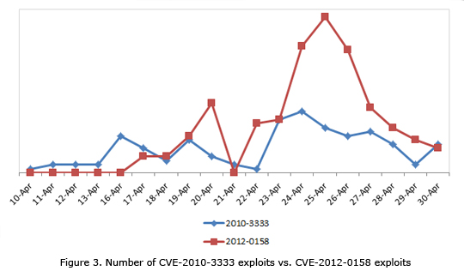
Vulnerabilities and threats
Successful threats are long-lived
Vulnerabilities slow to be patched
New vulnerabilities are quickly exploited

Slide 47
Controls
Popular classification
Physical controls
Traditional non-technical methods of preventing harm
E.g. background checks, locks
Procedural controls
Prescribed plans of action that govern the use of computer resources
E.g. double entry book-keeping
Two principles
Personal accountability
Forced co-operation
“When thieves fall out, honest men get their dues”
Technical controls
Security measures built into the information system itself
E.g. Automatic updates, firewalls, passwords

Slide 48
Controls
Large organizations
Procedures are very important
Replicate proven methods across all employees
Fuzzy categories
Most controls fall under multiple categories
E.g. Passwords
Technical?
Procedural?
Physical?

Slide 49
Summary
Basic information security model
Traditional security vs. information security
Common vulnerabilities
Important threats
Popular controls

